Slide 1

Green Pace
Security Policy Presentation
Developer: Nicholas Feero

Slide 2

OVERVIEW: DEFENSE IN DEPTH
Ensure all staff are creating, deploying, and supporting custom software in a safe, informed manner.
Needed to protect Green Pace’s assets and establish regulations for security.
Used as a framework for constructing and implementing security layers by addressing vulnerabilities.

Slide 3
THREATS MATRIX
Likely String Correctness SQL Injection Memory Protection | Priority Data Value
Low priority Exceptions | Unlikely Data Type Assertions Object-Oriented Programming Concurrency Input Output (I/O)

Slide 4
10 PRINCIPLES
Validate Input Data
Heed Compiler Warnings
Architect and Design for Security Policies
Keep It Simple
Default Deny
Adhere to the Principle of Least Privilege
Sanitize Data Sent to Other Systems
Practice Defense in Depth
Use Effective Quality Assurance Techniques
Adopt a Secure Coding Standard

Slide 5
CODING STANDARDS
1.) Data Value – Do not read uninitialized memory
2.) SQL Injection – Sanitize data passed to complex subsystems
3.) Memory Protection – Do not access freed memory
4.) String Correctness – Guarantee that storage for strings has sufficient space for character data and the null terminator
5.) Exceptions – Do not leak resources when handling exceptions
6.) Concurrency – Preserve thread safety and liveness when using condition variables
7.) Input Output (I/O) – Close files when they are no longer needed
8.) Object-Oriented Programming – Write constructor member initializers in the canonical order
9.) Assertions – Use a static assertion to test the value of a constant expression
10.) Data Type – Do not write syntactically ambiguous declarations

Slide 6
ENCRYPTION POLICIES
Encryption at rest
Sensitive data that is being stored in any capacity (servers, databases, systems, etc.) must be encrypted by utilizing a proven encryption algorithm with secure key management.
Encryption in flight
Sensitive data being transmitted must be encrypted using a secure method to protect against interception.
Encryption in use
Sensitive data actively being processed in memory must be protected with encryption techniques and encryption-handling environments.

Slide 7
TRIPLE-A POLICIES
Authentication
Users, devices, and software must prompt a secure verification of identity before granting access to a system or data.
Authorization
Users, systems, and processes are only granted the minimum necessary privileges to perform the expected actions of their role.
Accounting
All information regarding a system’s activity must be logged and retained for a defined period and reviewed frequently.

Slide 8
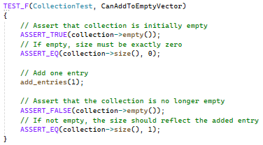
Unit Testing CanAddToEmptyVector

Slide 9
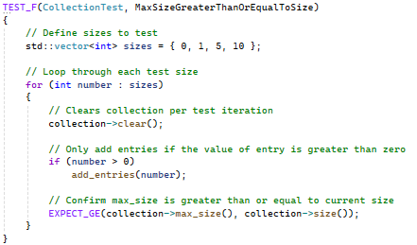
Unit Testing MaxSizeGreaterThanOrEqualToSize

Slide 10
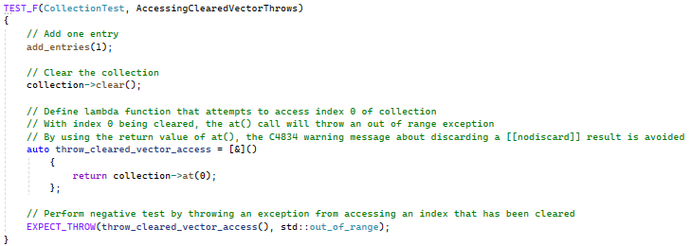
Unit Testing AccessingClearedVectorThrows

Slide 11
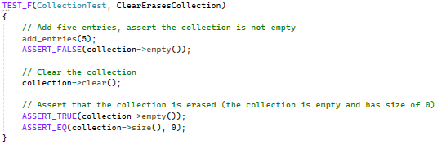
Unit Testing ClearErasesCollection

Slide 12
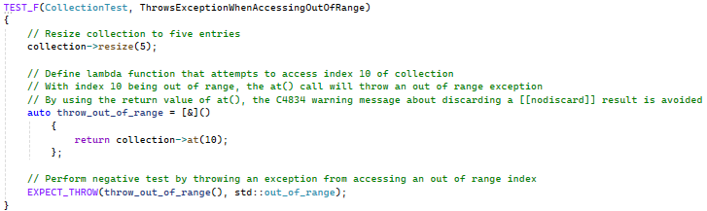
Unit Testing ThrowsExceptionWhenAccessingOutOfRange

Slide 13
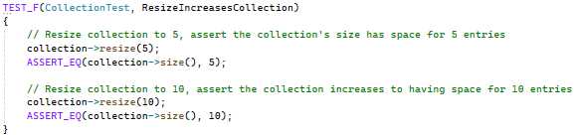
Unit Testing ResizeIncreasesCollection

Slide 14

AUTOMATION SUMMARY

Slide 15
TOOLS
Threat Modeling
Open Worldwide Application Security Project (OWASP)
Static Application Security Testing (SAST)
Dynamic Application Security Testing (DAST)
Unit Testing
Security Information and Event Management (SIEM)

Slide 16
RISKS AND BENEFITS
Proactive vs. Retroactive Security Practices
“Don’t leave security to the end.”
Defense in depth
Sunk cost
Motive
Feasibility
Be proactive!

Slide 17
RECOMMENDATIONS
Define trusted repositories, libraries, and resources to establish a base for each developer to implement in their code.
For each principle and standard, developing a standard to determine if their criteria are being successfully met may improve confidence in development.
Define a trusted method of encryption to standardize the practice across the company.
Establish an incident report and response protocol for instances of potential compromised data.

Slide 18
CONCLUSIONS
Without a well-defined security policy with clear acceptance criteria, data can be left vulnerable and susceptible to breaches. Establishing a framework for protecting data provides developers the knowledge to properly handle, store, and transmit data without compromising the integrity of the code (Data Security Policies, n.d.).
Example: HIPAA
Relevant legal and regulatory standards need to be adopted dependent on the scope (location and scale of the company’s operations).
Adhere to established standards! Unprepared changes in structure and standards can create a snowball effect of problems. If changes need to be made, prepare accordingly and establish a timeline to guide the transition.

Slide 19
REFERENCES
Data Security Policies: Why They Matter and What They Contain. (n.d.). Palo Alto Networks. Retrieved August 13, 2025, from https://www.paloaltonetworks.com/cyberpedia/data-security-policy
Rights (OCR), O. for C. (2009, November 20). Summary of the HIPAA Security Rule [Page]. https://www.hhs.gov/hipaa/for-professionals/security/laws-regulations/index.html

